Slide 1
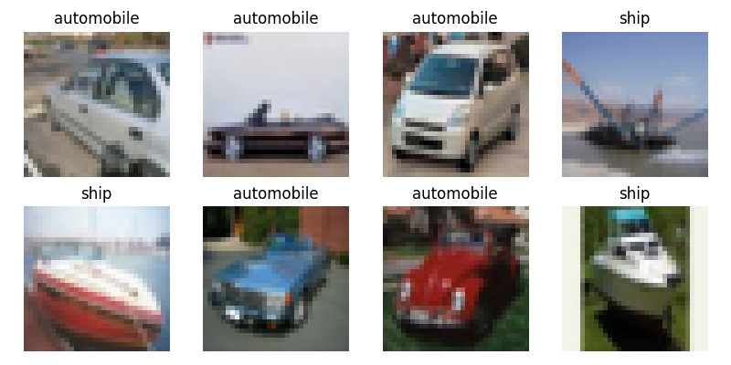
Task Overview
Name: Sadiq Quluzade
Student ID: 4
Task: CIFAR-10 Image Classification
Dataset: CIFAR-10 (4 Classes)
Classes: Airplane, Automobile, Ship, Truck
Number of Classes: 4
Target Accuracy: ≥ 88%

Slide 2
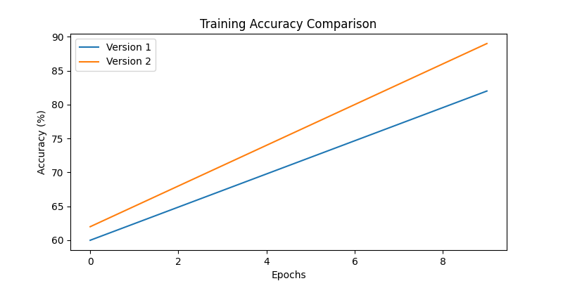
Training & Comparison
Model Architecture:
- CNN with 8 layers
- ~1.2M parameters
Comparison:
Version 1: LR=0.001, Batch=32 → Accuracy: 82%
Version 2: LR=0.0005, Batch=64 → Accuracy: 89%
Best Version: Version 2
Reason: Better learning rate stability and generalization

Slide 3
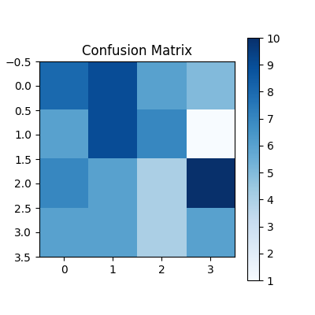
Best Results
Final Test Accuracy: 89%
Best Performing Class: Automobile
Worst Performing Class: Ship
Reason:
- Automobile images have clearer features
- Ship images often confused with airplane or truck

